Slide 1
Quantum Algorithms and Cryptography
Gorjan Alagic
QMATH, University of Copenhagen
www.alagic.org

Slide 2
I. Quantum ComputerS?

Slide 3
Quantum computers?
An idea: computation is a physical process.
Math/CS/Logic: computation as a mathematical abstraction
CE/EE/Physics: computation using real devices
We need abstractions that are faithful to what we can actually build;
Such abstractions should respect the laws of physics!
What if…
… we could equip our laptops with tiny time machines*?
… we could travel near the speed of light (time dilation)?
… we could control quantum states?
*to see what really happens, look at research on computation and CTCs.

Slide 4
Quantum computers?
An idea: computation is a physical process.
Math/CS/Logic: computation as a mathematical abstraction
CE/EE/Physics: computation using real devices
We need abstractions that are faithful to what we can actually build;
Such abstractions should respect the laws of physics!
What if…
… we could equip our laptops with tiny time machines*?
… we could travel near the speed of light (time dilation)?
… we could control quantum states?
and take full advantage of
*to see what really happens, look at research on computation and CTCs.

Slide 5
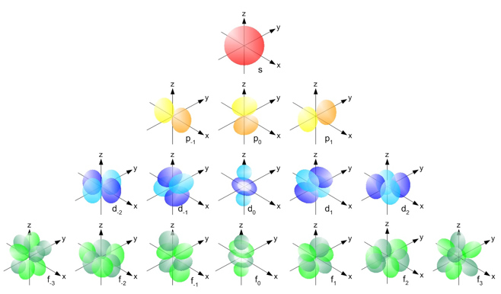
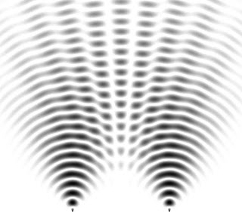
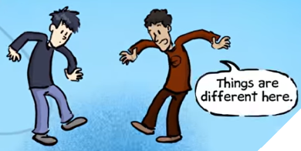
Quantum computers?
Quantum states?
Many others: electron spin, photon polarization, nuclear spin…
Weird properties: superposition, interference, entanglement, uncertainty;
Why weird? Daily life is about classical states: time, our position/velocity, Earth w.r.t. Sun, contents of Facebook, …
electrons in an atomic orbital
photons in beams of light
*
*PhD Comics: Quantum Computers Animated

Slide 6
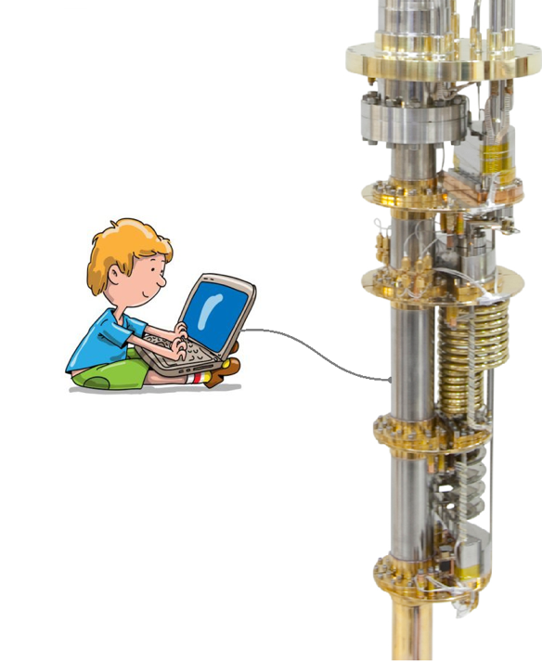
Quantum computers?
So… what IS a quantum computer?
It’s a computer just like the ones you use now… but which operates internally on very different principles.
What stays the same?
interface: touchscreen, mouse+keyboard;
inputs/outputs: numbers, text files, images, databases...;
what is computable: no halting problem or meaning-of-life;
What is different?
inner workings: quantum mechanics instead of electromagnetism;
what is computable quickly: some problems solved in minutes instead of centuries.

Slide 7
Quantum computers?
Why should you care?
Cool science: a re-invention of the device that forms the basis of the modern world, and a great excuse to learn new physics!
Great theory: basic notions of computer science need updating (information theory, error-correction, cryptography, algorithms, computational complexity…)
Practical impact: Public-key cryptography will have to change dramatically; some hard problems in quantum physics, chemistry, and materials could be solved (e.g., room-temp superconductivity?);
… and it’s likely that lots of stuff is yet to be discovered.

Slide 8
II. BASIC Theory

Slide 9
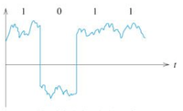
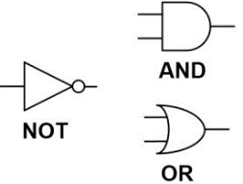
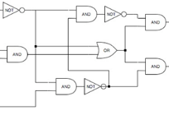
Basic theory: classical
First, how does a normal (classical) computer work? (e.g., phone, laptop, supercomputer, autopilot, etc.)
Basic principles of classical computation:
data: bits take values in $\{0, 1\}$ (physically: high/low voltage);
basic logic: boolean gates (physically: switch transistors);
advanced logic: boolean circuits (physically: digital circuits);
algorithms: high-level code which can be compiled into circuits.

Slide 10
Basic theory: quantum
complex numbers
Basic principles of quantum computation:
Brief overview:
data: qubits take values which are superpositions $a\left|0\right\rangle +b\left|1\right\rangle$ of $0$ and $1$;
basic logic:
measure qubit to get classical bit: $\operatorname{Pr}\left[0\right]={\left|a\right|}^{2}$ and $Pr[1]{=\left|b\right|}^{2}$.
apply a unitary gate (preserves ${\left|a\right|}^{2}+{\left|b\right|}^{2}=1$).
advanced logic:
combine multiple qubits, and two-qubit unitary gates;
combine many qubits and gates to get quantum circuits;
algorithms: high-level code which can be compiled into quantum circuits.
let ops (qs:Qubits) =
H qs
let q0 = qs.Head
for i in 1..qs.Length-1 do CNOT !!(qs,0,i)
M >< qs // Measure all the qubits
Actual code from Microsoft’s Liquid (a quantum extension of F#)

Slide 11
Basic theory: ONE qubit
Smallest possible quantum computer: one qubit.
classical bit takes values in $\{0, 1\}$;
quantum bit (qubit) can also take these values; we call them $|0⟩$ and $|1⟩$.
but a qubit can also be in a superposition:
$$a\left|0\right\rangle +b\left|1\right\rangle$$
here $a, b$ are complex numbers satisfying ${\left|a\right|}^{2}+{\left|b\right|}^{2}=1$.
Don’t give up already: this is not so weird! An analogy:
the state of a coin is described by a classical bit ($0=heads, 1=tails$).
if I flip the coin but hide the result, it’s state is a combination:
$$a⋅\left[heads\right]+b⋅\left[tails\right]$$
here $a, b$ are real numbers satisfying $a+b=1.$
$$|1⟩$$
$$|0⟩$$

Slide 12
Basic theory: ONE qubit
Smallest possible quantum computer: one qubit.
What can I do with it?
Measure (collapse) it to get a classical bit:
Apply a linear operation which preserves the property ${\left|a\right|}^{2}+{\left|b\right|}^{2}=1\text{, }\text{e}\text{.}\text{g}\text{.,}$
$X$ gate: $\left|0\right\rangle ↦\left|1\right\rangle ; \left|1\right\rangle ↦\left|0\right\rangle$ (classical NOT)
$Z$ gate: $\left|0\right\rangle ↦\left|0\right\rangle ; \left|1\right\rangle ↦−\left|1\right\rangle$
$H$ gate: $\left|0\right\rangle ↦\frac{1}{\sqrt{2}}\left|0\right\rangle +\frac{1}{\sqrt{2}}\left|1\right\rangle ; \left|1\right\rangle ↦\frac{1}{\sqrt{2}}\left|0\right\rangle −\frac{1}{\sqrt{2}}\left|1\right\rangle$
The only way to access information in qubits! We *cannot* look at $a, b!$
$|0⟩$with probability ${\left|a\right|}^{2}$
$$a\left|0\right\rangle +b\left|1\right\rangle$$
$|1⟩$with probability ${\left|b\right|}^{2}$
Hey, that looks like the Fourier transform over $ℤ_{2}$!

Slide 13
Basic theory: ONE qubit
Smallest possible quantum computer: one qubit.
What can I do with it?
Measure (collapse) it to get a classical bit:
Apply a unitary (distance-preserving) operation, e.g.,
$X$ gate: $\left[\begin{matrix}\text{0} & \text{1} \\ \text{1} & \text{0}\end{matrix}\right]$ (classical NOT)
$Z$ gate: $\left[\begin{matrix}\text{1} & \text{0} \\ 0 & −1\end{matrix}\right]$
$H$ gate: $\frac{1}{\sqrt{2}}\left[\begin{matrix}\text{1} & 1 \\ 1 & −1\end{matrix}\right]$
The only way to access information in qubits! We *cannot* look at $a, b!$
$$\left[\begin{aligned}a \\ b\end{aligned}\right]$$
$|0⟩$with probability ${\left|a\right|}^{2}$
$|1⟩$with probability ${\left|b\right|}^{2}$
Hey, that looks like the Fourier transform over $ℤ_{2}$!

Slide 14
Basic theory: MANY QUBITS
What if I have multiple qubits?
the state of an n-bit classical system is described by n bits.
the state of an n-qubit quantum system is a superposition of the classical states:
$$\left|φ\right\rangle =\sum_{x∈{\left\{0,1\right\}}^{n}}{a_{x}|x⟩}$$
where the ${|a}_{x}{\left.​\right|}^{2}$ must again sum to 1. This is a $2^{n}$-D complex vector of length one.
Example (two qubits):
a valid two-qubit state: $\frac{1}{\sqrt{2}}\left|00\right\rangle +\frac{1}{\sqrt{2}}\left|11\right\rangle ;$to extract anything, I must measure;
measuring first qubit yields $0$ or $1$, each with probability ½;
this result also determines the state of the other qubit : they are equal!
we say that the qubits were entangled.
In the linear algebra picture, we are taking the tensor product of the qubit spaces.

Slide 15
Basic theory: MANY QUBITS
Operations on multiple qubits.
How to prepare the state $\frac{1}{\sqrt{2}}\left|00\right\rangle +\frac{1}{\sqrt{2}}\left|11\right\rangle$?
Apply H to first qubit: $|0⟩|0⟩↦ (|0⟩+|1⟩)|0⟩=|00⟩+|10⟩$
Apply CNOT: $|00⟩+|10⟩↦|00⟩+|11⟩$
Note: each gate is *reversible* (has an inverse.) This is guaranteed by unitarity.
By adding more qubits and choosing different gate sequences, we can describe any quantum computation (just like with classical Boolean circuit model.)
$$\left[\begin{aligned}1 0 0 0 \\ 0 1 0 0 \\ 0 0 0 1 \\ 0 0 1 0\end{aligned}\right]$$
$$|0⟩$$
$$H$$
$$|0⟩$$
$$X$$
Control-NOT (CNOT) gate

Slide 16
III. Quantum algorithms

Slide 17
Quantum algorithms
Building more complex quantum circuits.
This implements: $|00⟩↦ (|0⟩+|1⟩)$ $(|0⟩+|1⟩)=|00⟩+|01⟩+|10⟩+|11⟩.$
This is called a uniform superposition.
$$|0⟩$$
$$H$$
$$|0⟩$$
$$H$$

Slide 18
Quantum algorithms
Building more complex quantum circuits.
This implements $\left|0^{n}\right\rangle ↦\sum_{x∈{\left\{0,1\right\}}^{n}}{|x⟩}$ : uniform superposition over all classical states!
$$|0⟩$$
$$H$$
$$n$$
$$|0⟩$$
$$H$$

Slide 19
Quantum algorithms
Building more complex quantum circuits.
This implements $\left|0^{n}\right\rangle |0^{n}⟩↦\sum_{x∈{\left\{0,1\right\}}^{n}}{\left|x\right\rangle }|0^{n}⟩$
$$|0⟩$$
$$H$$
$$n$$
$$|0⟩$$
$$H$$
$$|0⟩$$
$$n$$
$$|0⟩$$

Slide 20
Quantum algorithms
Pick a classical function $f:{\left\{0,1\right\}}^{n}→{\left\{0,1\right\}}^{n}.$
This implements $\left|0^{n}\right\rangle |0^{n}⟩↦\sum_{x∈{\left\{0,1\right\}}^{n}}{\left|x\right\rangle }|0^{n}⟩↦\sum_{x∈{\left\{0,1\right\}}^{n}}{\left|x\right\rangle }|f(x)⟩$.
$$|0⟩$$
$$H$$
classical circuit for
$$\left(x, 0\right)↦(x, f\left(x\right))$$
$$n$$
$$|0⟩$$
$$H$$
$$|0⟩$$
$$n$$
$$|0⟩$$

Slide 21
Quantum algorithms
Pick a classical function $f:{\left\{0,1\right\}}^{n}→{\left\{0,1\right\}}^{n}.$
This implements $\left|0^{n}\right\rangle |0^{n}⟩↦\sum_{x∈{\left\{0,1\right\}}^{n}}{\left|x\right\rangle }|0^{n}⟩↦\sum_{x∈{\left\{0,1\right\}}^{n}}{\left|x\right\rangle }|f(x)⟩$.
$$|0⟩$$
$$H$$
classical circuit for
$$\left(x, 0\right)↦(x, f\left(x\right))$$
$$n$$
$$X$$
$$|0⟩$$
$$H$$
$$|0⟩$$
$$n$$
$$X$$
$$|0⟩$$
We computed $f$ in superposition, over all possible inputs!

Slide 22
Quantum algorithms
Pick a classical function $f:{\left\{0,1\right\}}^{n}→{\left\{0,1\right\}}^{n}.$
This implements $\left|0^{n}\right\rangle |0^{n}⟩↦\sum_{x∈{\left\{0,1\right\}}^{n}}{\left|x\right\rangle }|0^{n}⟩↦\sum_{x∈{\left\{0,1\right\}}^{n}}{\left|x\right\rangle }|f(x)⟩$.
you may have read that quantum computers “try all answers at once”…
… but we know that you have to measure to extract information!
measuring this state fully yields $\left|x\right\rangle |f\left(x\right)⟩$ for random $x$. This is easy classically!
$$|0⟩$$
$$H$$
classical circuit for
$$\left(x, 0\right)↦(x, f\left(x\right))$$
$$n$$
$$X$$
$$|0⟩$$
$$H$$
$$|0⟩$$
$$n$$
$$X$$
$$|0⟩$$
We computed $f$ in superposition, over all possible inputs!

Slide 23
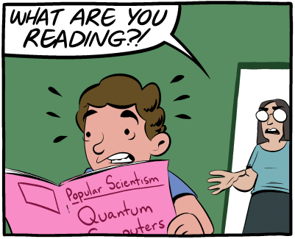
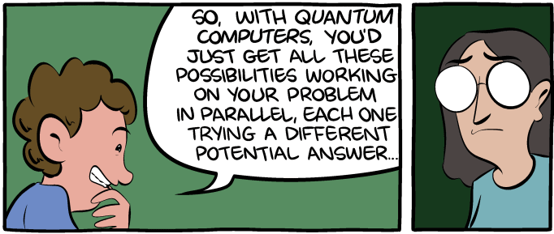
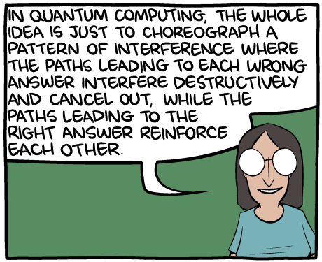
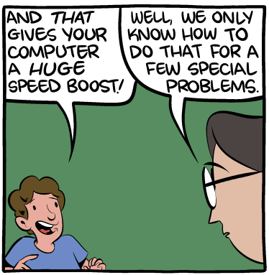
Quantum algorithms
“The talk” by Scott Aaronson and Zach Weinersmith
More complex quantum circuits.
This implements $\left|0^{n}\right\rangle |0^{n}⟩↦\sum_{x∈{\left\{0,1\right\}}^{n}}{\left|x\right\rangle }|0^{n}⟩↦\sum_{x∈{\left\{0,1\right\}}^{n}}{\left|x\right\rangle }|f(x)⟩$.
this is where the media claims about “trying all answers at once” come from…
… but we know that you have to measure to extract information!
measuring this state fully yields $\left|x\right\rangle |f\left(x\right)⟩$ for random $x$. This is easy classically!
$$|0⟩$$
$$H$$
classical circuit for
$$\left(x, 0\right)↦(x, f\left(x\right))$$
$$n$$
$$X$$
$$|0⟩$$
$$H$$
$$|0⟩$$
$$n$$
$$X$$
$$|0⟩$$
We computed $f$ in superposition, over all possible inputs!

Slide 24
Quantum algorithms
Do something clever?
This implements $\left|0^{n}\right\rangle |0^{n}⟩↦\sum_{x∈{\left\{0,1\right\}}^{n}}{\left|x\right\rangle }|0^{n}⟩↦\sum_{x∈{\left\{0,1\right\}}^{n}}{\left|x\right\rangle }|f(x)⟩$.
$$|0⟩$$
$$H$$
classical circuit for
$$\left(x, 0\right)↦(x, f\left(x\right))$$
$$n$$
$$X$$
$$|0⟩$$
$$H$$
$$|0⟩$$
$$n$$
$$X$$
$$|0⟩$$

Slide 25
Quantum algorithms
Do something clever?
Remember: Fourier Transform rewrites a function in the Fourier basis (think: sines and cosines with varying frequencies.)
The QFT circuit can be constructed recursively, analogous to FFT circuits;
Crucial difference: it acts on functions with exponentially-large domain!
$$|0⟩$$
$$H$$
classical circuit for
$$\left(x, 0\right)↦(x, f\left(x\right))$$
Quantum Fourier Transform
(QFT)
$$n$$
$$|0⟩$$
$$H$$
$$|0⟩$$
$$n$$
$$|0⟩$$

Slide 26
Quantum algorithms
In some cases (over $ℤ_{2}^{n}$), QFT is very simple!
Do something clever?
Remember: Fourier Transform rewrites a function in the Fourier basis (think: sines and cosines with varying frequencies.)
The QFT circuit can be constructed recursively, analogous to FFT circuits;
Crucial difference: it acts on functions with exponentially-large domain!
$$|0⟩$$
$$H$$
classical circuit for
$$\left(x, 0\right)↦(x, f\left(x\right))$$
$$H$$
$$n$$
$$|0⟩$$
$$H$$
$$H$$
$$|0⟩$$
$$n$$
$$|0⟩$$

Slide 27
Quantum algorithms
Why take Fourier transform?
our problem: we must measure $⇒$we can only sample;
sampling values of $f$ can be done classically, so no advantage there;
what about sampling the Fourier transform?
Upshot: an efficient quantum algorithm for computing the period of a function!
This might sound boring, but it’s actually pretty amazing… here’s why.
exponentially-large period
here we have to sample
exponentially-many times and
hope for collisions…
here every sample gives lots
of information!

Slide 28
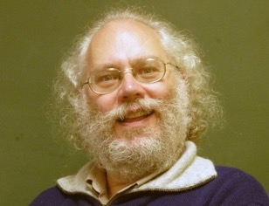
Shor’s algorithm
How to find a factor of $N$ in polynomial time:
pick a random number $a<N$, compute $gcd⁡(a, N)$;
if $gcd(a, N)≠1$, output it; else compute period $r$ of function $f(x)=a^{x} mod N$.
If $r$ is odd or $a^{r/2}=−1 mod N$, go back to step 1.
output $gcd⁡(a^{r/2} + 1, N)$.
Not obvious that this works (need some number theory). But classical parts are simple!
Similar techniques give an efficient quantum algorithm for discrete log problem:
Given integers $b$ and $x$ modulo $N$, find $a$ such that $b^{a}=x mod N$.
(i.e., compute $dlog_{b}\left(x\right).$)
Why should you care if factoring and discrete log can be computed efficiently?

Slide 29
IV. cryptography

Slide 30
Internet cryptography
An amazing achievement: secure communication…
across a planetwide, high-bandwidth network (~3.5 billion users),
with minimal inconvenience to end-users.
How? A revolution in classical cryptography in the 70s:
secure key exchange over completely public channels;
extremely efficient cryptography with strong security guarantees;

Slide 31
Cryptography: Encryption
Alice wants to send a message $m$ to Bob.
Alice
message $m$;
Internet: completely insecure!
Bob

Slide 32
Cryptography: Encryption
Alice wants to send a message $m$ to Bob.
Fix a prime $p$, and set $ℤ_{p}^{∗}=\left\{1,2,…,p−1\right\};$
Recall multiplication modulo $p$ : for $x, y∈ℤ_{p}^{∗}$ , $x⋅y mod p∈ℤ_{p}^{∗}$.
Alice
secret $s∈_{R}ℤ_{p}^{∗}$;
message $m$;
Internet: completely insecure!
Bob
secret $s∈_{R}ℤ_{p}^{∗}$;

Slide 33
Cryptography: Encryption
Alice wants to send a message $m$ to Bob.
Fix a prime $p$, and set $ℤ_{p}^{∗}=\left\{1,2,…,p−1\right\};$
Recall multiplication modulo $p$ : for $x, y∈ℤ_{p}^{∗}$ , $x⋅y mod p∈ℤ_{p}^{∗}$.
Ok great. But how do Alice and Bob agree on this secret number $s$?
Alice
secret $s∈_{R}ℤ_{p}^{∗}$;
message $m$;
convert $m↦x∈ℤ_{p}^{∗};$
set$c= x⋅s mod p$;
send $c$;
Bob
secret $s∈_{R}ℤ_{p}^{∗}$;
receive $c$;
set $m=c⋅s^{−1} mod p.$
Internet: completely insecure!
check: $c$ looks completely
random to anyone here

Slide 34
Cryptography: key exchange
INTERNET
=
BROKEN
Diffie-Hellman key exchange.
Alice and Bob want to agree on a secret, random key $s∈ℤ_{p}^{∗}$.
This has been used (without incident) to exchange keys on Internet since its inception.
Alice
Internet: completely insecure!
Bob
Choose $p$ and “small” $g∈ℤ_{p}^{∗}$.
$$(p, g)$$
Quantum attack:
$$dlog_{g}\left(A\right)= a;$$
$$dlog_{g}\left(B\right)=b;$$
$$g^{ab}=s.$$
Choose $a∈_{R}ℤ_{p}^{∗},$
set $A=g^{a}.$
$$A$$
$$B$$
Choose ${b∈}_{R}ℤ_{p}^{∗},$
set $B=g^{b}.$
Key is $s=B^{a}={\left(g^{b}\right)}^{a}=g^{ab}.$
Key is $s=A^{b}={\left(g^{a}\right)}^{b}=g^{ab}.$

Slide 35
Cryptography: post-quantum?
So what do we do now?
Don’t panic (yet)! Quantum computers big enough to crack crypto still far away.
Use this time to figure out what to do when they show up!
Quantum-safe primitives?
The Diffie-Hellman key exchange relied on the assumption “discrete log is hard.”
Can also build crypto from other assumptions, like “noisy linear algebra is hard.”
Is this quantumly hard? We don’t know!
short “noise” vector

Slide 36
V. What else is out there?
(a lot!)

Slide 37
Quantum computation: There’s a lot to do!
Thanks!
There is so much that we did not talk about…
quantum algorithms: simulating quantum systems, unstructured search, linear algebra, machine learning, topology…
quantum information theory: entropy, channels, coding, capacity, etc. for the setting of communicating quantum data (or classical data with quantum means);
quantum cryptography: using quantum mechanics to perform cryptographic tasks that are provably impossible classically;
quantum complexity: quantum versions of P, BPP, NP, etc., their relationships with each other and with classical complexity;
other models: topological quantum computation, measurement-based models, quantum walks, quantum Turing Machines, …
how to build it: how to engineer and manipulate qubits (superconducting circuits, ion traps, quantum dots, NMR, linear optics, etc.)
error-correction and fault-tolerance: how to assemble many noisy qubits in order to produce one that can be used to compute for as long as needed;
theoretical physics: connections to high-energy physics and BLACK HOLES!
…

